Slide 1
Pitch Deck Cultural Connections Calendar
Tawfik El mouttaqi
Cường Minh Nguyễn
Eric Wall

Slide 2
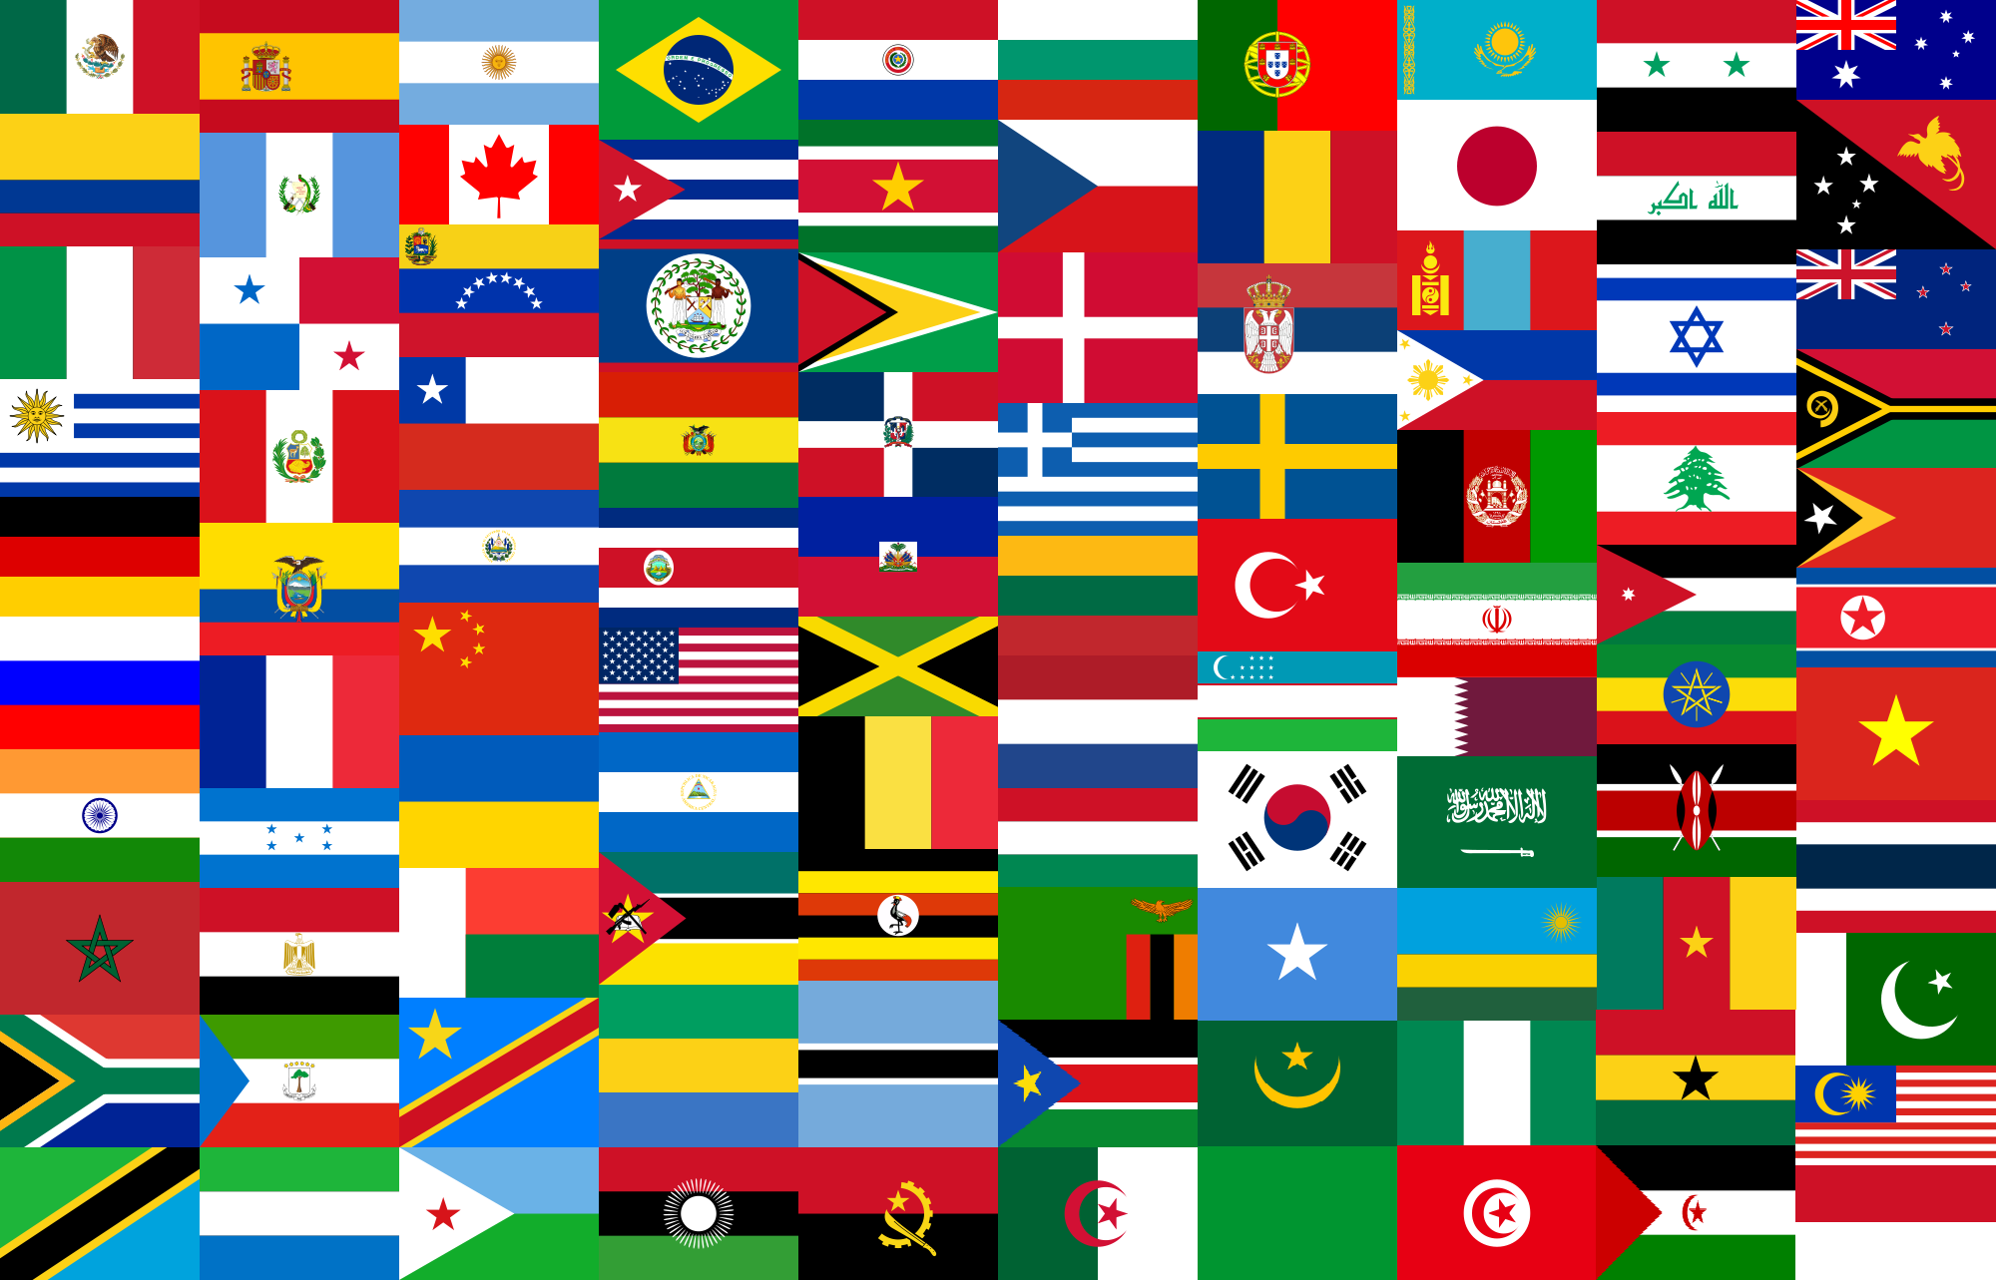
About Us
We are Team ETC. As newly minted full stack developers, we wanted to attempt something that we had not seen before rather than rehashing something familiar. So, we decided to create an application with the purpose of bringing people together in a positive and constructive way.

Slide 3
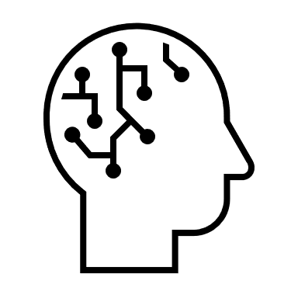

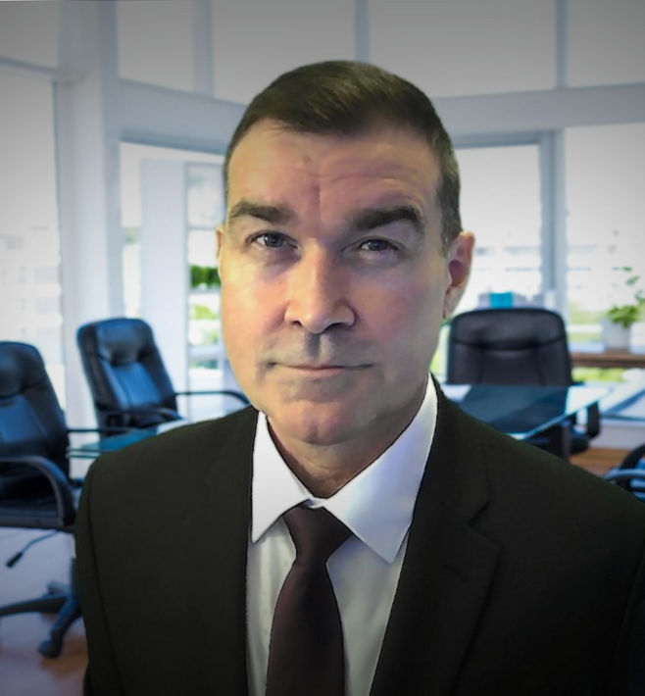
Our team
Cường Minh Nguyễn
Tawfik el mouttaqi​​
Eric Wall​​
College grad
College grad
STEM CTE Teacher
Career Changer
Dev10 provides opportunity

Slide 4
Problem
Losing Connections
Cultural Diversity
While Internet connections increase, human connections decrease when shared experiences diminish
As a nation built on immigration, the US has one of the most culturally and ethnically diverse populations on the planet
Post-Pandemic Rush
Societal Barriers
Many people are flocking out in search of positive, meaningful activities
Some predominant US political and religious groups advocate for the exclusion or assimilation of differing cultures

Slide 5

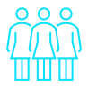


Solution
Create an App
Target audience
Connect together
Easy to use
Our app makes it easy to schedule an event that can be shared with others
People with shared cultural heritages and people of different cultural heritages who wish to learn about other cultures
Provide an opportunity to not only remember our past, but to foster a peaceful and tolerant future for all
Familiar calendar design that allows tech and non-tech people alike to access events and event planning

Slide 6

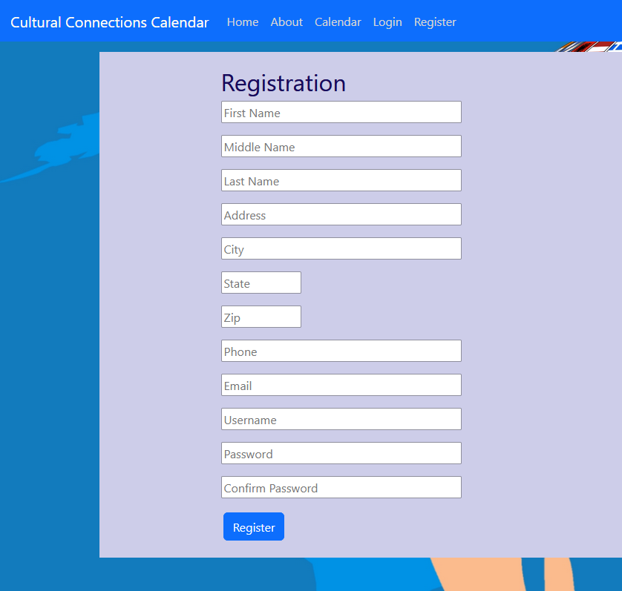
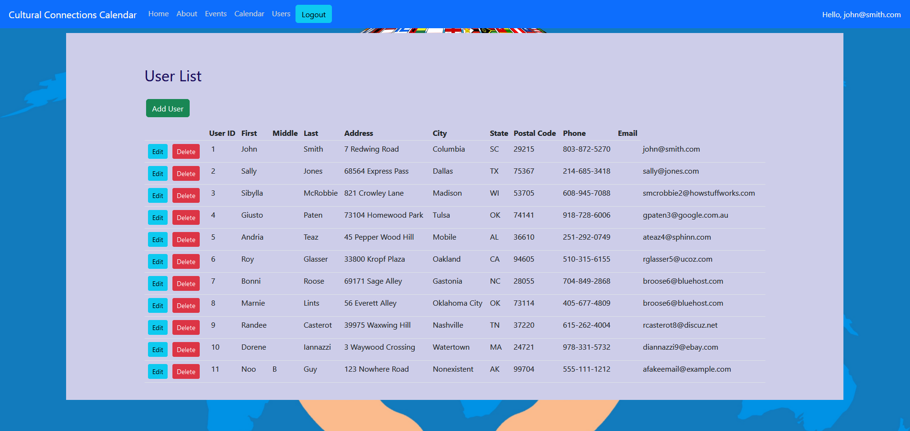


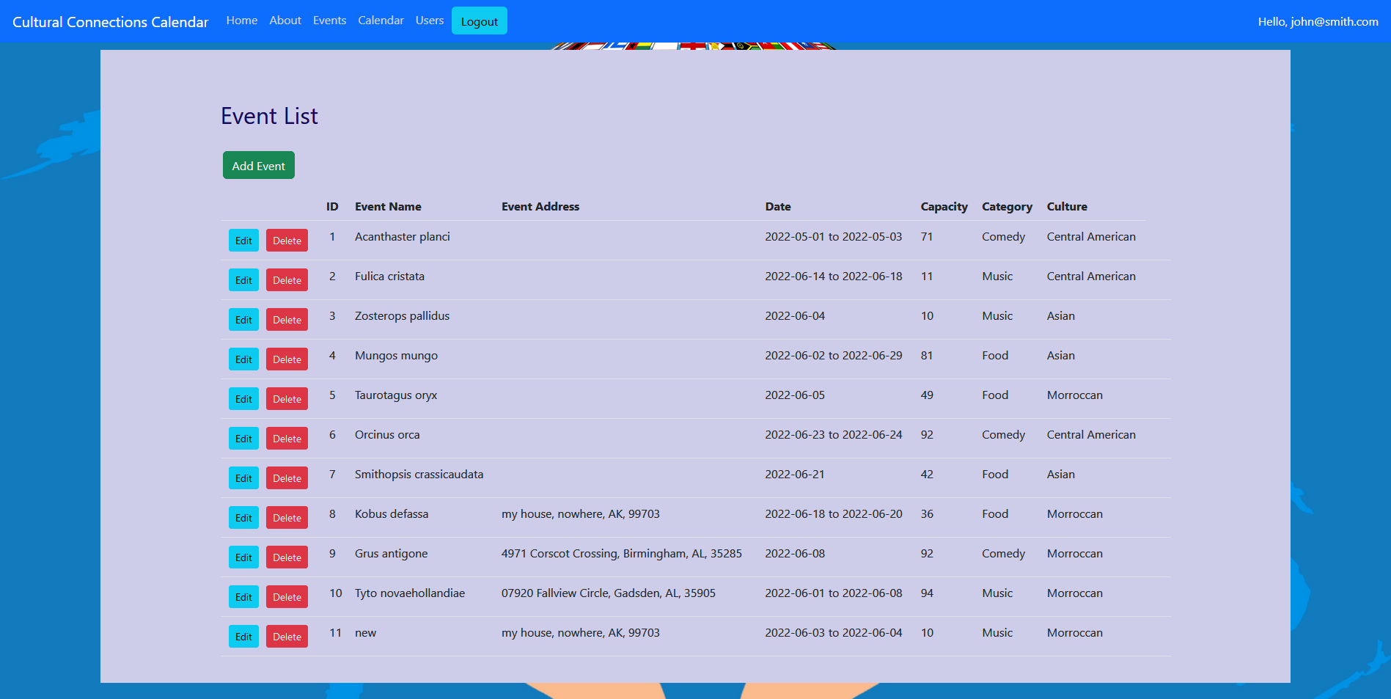
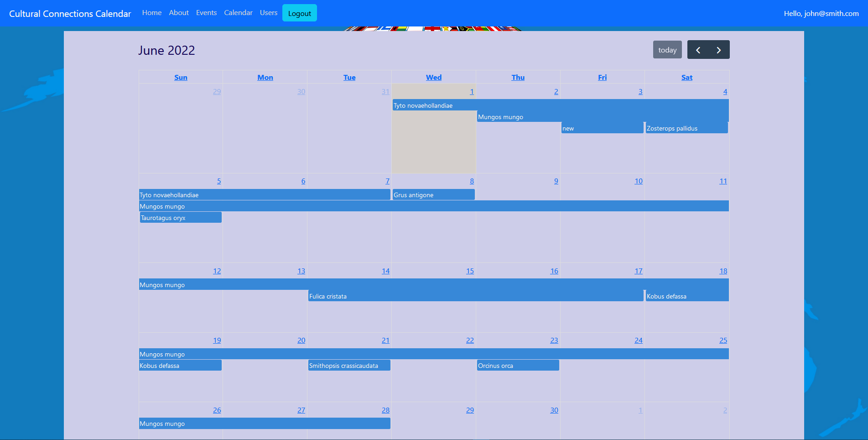
Product Overview
New User Registration
Admin User View
Admin Event View
Calendar View

Slide 7
Product Benefits
Easy and familiar to use
Opportunities for community connections
Fosters togetherness and community

Slide 8
Coding Languages
2.6%
3.4%
30%
64%
HTML
CSS
JavaScript
Java

Slide 9









Our tech
OpenJDK 17
MySQL
Spring & Spring Boot​​
Spring Security
Server
Database
Server Framework & Microservices
Server Security
Node.js
React
Docker​
AWS​
Client Runtime Environment
​
Client
Containerization
Cloud Distribution​

Slide 10
Summary
Our application, the Cultural Connections Calendar, is designed to allow people to create gatherings, great and small, which celebrate their rich cultural diversity in a positive and educational way.
In the ongoing wake of the Covid-19 pandemic, people are eager to get out and experience things old and new. Many people had the opportunity to learn about things in our world while in isolation and are eager to experience them live. With current global and national conditions such as they are, what better time to come together in the spirit of togetherness with those who seek to support a more hopeful future?

Slide 11
Thank you
Cường Minh Nguyễn
Tawfik El mouttaqi​
Eric Wall

